Slide 1
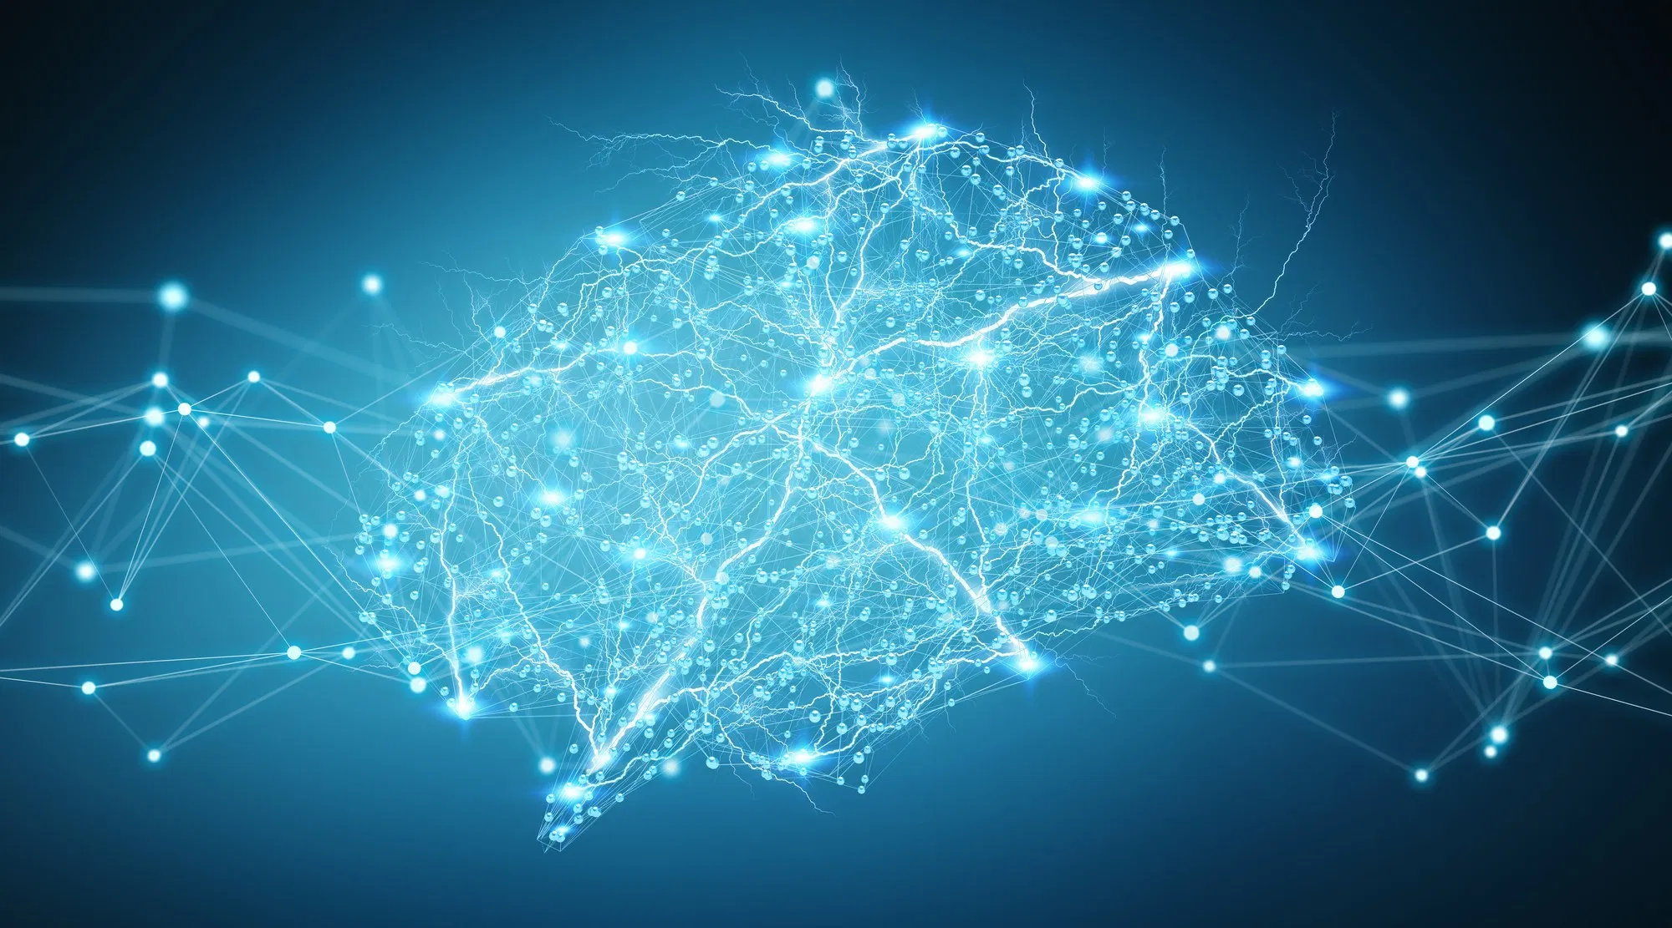
DL201+
A Deep Learning Workshop
Day 3
Benjamin Chew | Kok Zhao Jie | Shaun Tieon

Slide 2




Transfer learning
Motivation behind:
Existence of pre-trained models (Models that have been trained previously with weights and biases saved)
Not all of us have the unlimited computational power on our local machines
May have to make use of models that others have spent hours/days training

Slide 3
Transfer learning
Technique where you can use a neural network trained to solve a particular type of problem and with a few changes, you can reuse it to solve a related problem.
Freeze the early convolutional layers of the network and only train the last few layers which make a prediction.
Use a network trained on unrelated categories in a massive dataset (usually Imagenet) and apply it to our own problem because there are universal, low-level features shared between images

Slide 4
Transfer learning
Technique where you can use a neural network trained to solve a particular type of problem and with a few changes, you can reuse it to solve a related problem.
Saves time training model
Can still get decent results with a small dataset
Freeze the early convolutional layers of the network and only train the last few layers which make a prediction.
Use a network trained on unrelated categories in a massive dataset (usually Imagenet) and apply it to our own problem because there are universal, low-level features shared between images

Slide 5
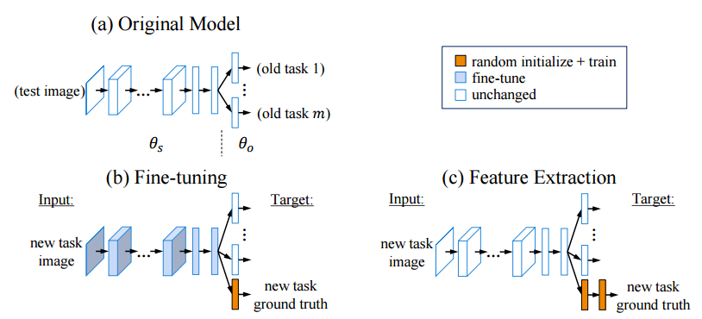
General steps for transfer learning
Fine Tuning: All layers of model will be optimized and “fine-tuned” during training based on a specific classification task
Feature Extraction: Freeze the bottom few layers, leaving only the last few layers unfrozen. Only the weights of the newly added last layers change during the training phase.

Slide 6
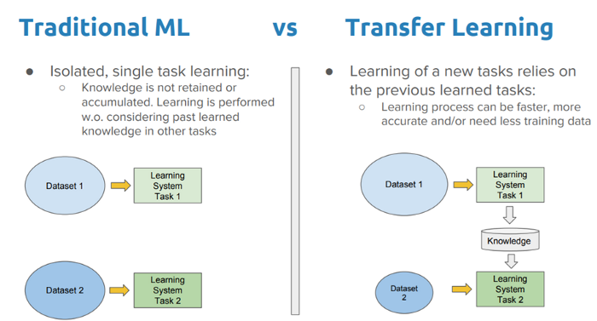

Slide 7
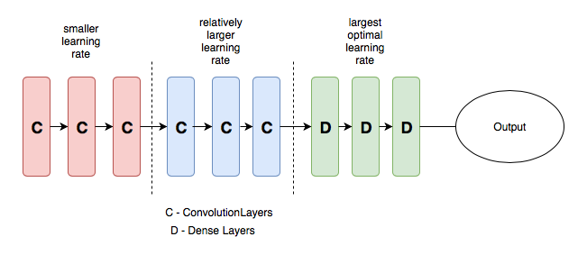
Discriminative Learning Rates
One technique to try to improve results
Method where you set different learning rates to different layers in the network during training

Slide 8




Discriminative learning rate
Intuitions:
First few layers typically contain very granular details of data, such as lines and edges
Normally would not want to change features extracted from earlier layers, likely to retain these information
Do not need to change weights a lot at the start, so learning rate is small at the start
In later layers, we would get more distinctive features for different models (e.g. eyeballs, nose), and we may not necessarily keep these features for our particular dataset
** Disclaimer: Technique may or may not improve results

